Slide 1
Language Modeling
NLP II 2025 Assoc. Prof. Attapol Thamrongrattanarit

Slide 2
Guess the next word
You will succeed if you don't give ___
In the morning, office workers like to stop by my favorite café on their way to ___
The BTS skytrain will take you from Siam to Ari in 10 ___

Slide 3

Predictive keyboard
The keyboards on smartphones and tablets are nearly unusable without this feature.

Slide 4
Write the rest of the sentence
To prepare for the job interview, it is advisable to ___
The bank account is overdrawn. In other words, you ___
The official languages of Switzerland are ___

Slide 5

Autosuggest
People and languages are somewhat predictable

Slide 6

Chatbot with a (large) language model
ChatGPT presents a language model that is very good at filling the rest of the text. This is indeed the golden age of language model and generative AI.

Slide 7
Which one sounds 'more English'?
The police officer told to the reporters about the incident. The police officer told the reporters about the incident.
อา นอน ตาก ลม อาน อน ตา กลม
I send him a letter. I send dim a led her.
Bangkok has many high buildings. Bangkok has many tall buildings.

Slide 8
Language Model (LM)
A model that 'understands' a language (or languages). In computational linguistics, a language model must be able to:
Compute the probability of a text - fluent text should get higher prob.
Generate text from the context - we want fluency and 'good' content
Predict the next word from the context - we want accuracy

Slide 9
Applications of Language Models
Fluent text generation requires contextual information
Chatbot
Machine translation
Automatic speech recognition (ASR or speech-to-text)
Summarization
Question answering
Grammatical error correction
Predictive keyboard and typing suggestions

Slide 10
Types of Language Models
n-gram language model uses normalized and smoothed counts of n-grams from a large dataset.
Neural language model
Recurrent Neural Network LM (RNN-LM) uses embeddings instead of counts to encode the context
Transformer-based language model is a large neural language model (billions of parameters) trained on a massive dataset (Billions of tokens)

Slide 11
Probability

Slide 12
Probability distribution over vocabulary
Probability measures how likely a word is to appear
A vocabulary is a list of words that we want to consider
A probability distribution P(W=w) over a vocabulary is a function
Input: w one of the word in the vocabulary
Output: P(w) probability of the word

Slide 13
Probability distribution over vocabulary (toy example)
w | กว้าง | กิน | ก่อน | ขาว | คน | ควร | จ่าย | จริง | ช่วย | ดี
P(W=w) | 0.026 | 0.165 | 0.072 | 0.050 | 0.009 | 0.009 | 0.003 | 0.110 | 0.050 | 0.068
w | เด็ก | ได้ | นี่ | มาก | รัก | ร้าน | เร็ว | สวย | อ่าน | ใหญ่
P(W=w) | 0.001 | 0.192 | 0.098 | 0.013 | 0.011 | 0.011 | 0.020 | 0.041 | 0.031 | 0.019
0 < P(W=w) < 1 for any value of w
The sum of all probabilities in a distribution must equal 1
We can sample a word from the distribution. A word with a high probability is more likely to be picked.

Slide 14
Conditional Probability
A conditional probability distribution is a probability distribution assuming that we know a new piece of knowledge (condition)
P(W | context ) is a conditional probability distribution over the vocabulary given the context on the left.
Context should determine what the probability distribution looks like (the next word is dependent on the context).

Slide 15
Probability of a string - calculating from left to right
P("โปรดมาเที่ยวที่เมืองของฉัน") = P(โปรด มา เที่ยว ที่ เมือง ของ ฉัน)
= P(โปรด | context = <s>) P(มา | context = <s> โปรด) P(เที่ยว | context = <s> โปรด มา) P(ที่ | context = <s> โปรด มา เที่ยว) P(เมือง | context = <s> โปรด มา เที่ยว ที่) P(ของ | context = <s> โปรด มา เที่ยว ที่ เมือง) P(ฉัน | context = <s> โปรด มา เที่ยว ที่ เมือง ของ)

Slide 16
n-gram Language Model

Slide 17
n-gram language model
A unigram language model computes the probability of a sentence assuming that context does not matter.
A bigram language model computes the probability of a sentence assuming that the only word to the left matters.
A trigram model assumes that only two words to the left matter.
4-gram 5-gram 6-gram

Slide 18
Unigram Language Model
Example: we want to compute the probabilities of these two sentences
Bangkok has many high buildings vs Bangkok has many tall buildings
P(Bangkok has many high buildings) = P(Bangkok) P(has) P(many) P(high) P(buildings) P(Bangkok) P(has) P(many) P(tall) P(buildings) = P(Bangkok) P(has) P(many) P(tall) P(buildings)

Slide 19
Estimating the unigram probability
unigram | count
…
buildings | 30
…
…
Bangkok | 7
…
…
has | 670
…
high | 60
…
…
…
tall | 43
…
…
…
…
…
P(Bangkok) = Count(Bangkok) Count of all unigrams
P(has) = Count(has) Count of all unigrams

Slide 20
Unigram Language Model fails here
P(Bangkok has many high buildings) = P(Bangkok) P(has) P(many) P(high) P(buildings) P(Bangkok has many tall buildings) = P(Bangkok) P(has) P(many) P(tall) P(buildings)

Slide 21
Unigram Language Model
P(w₁, w₂, w₃, …, w_{n}) = P(w₁) P(w₂) P(w₃) .. P(w_{n})
P(w) is estimated by counting the frequency of w normalized by the total counts of all unigrams.
What would happen if we use unigram model to make a predictive keyboard i.e. predictive the next word given the context?
You will succeed if you don't give ___

Slide 22
Generating from unigram
fifth an of futures the an incorporated a
a the inflation most dollars quarter in is mass
thrift did eighty said hard 'm july bullish
that or limited the
Notes:
What do you notice here?

Slide 23
Bigram model cares about the context
The context is provided by the previous word.
P(Bangkok has many high buildings) = P(Bangkok | context = <S>) P(has | context = <S> Bangkok) P(many | context = <S> has) P(high | context = <S> many) P(buildings | context = <S> high)

Slide 24
Estimating bigram probabilities
P(Bangkok | context = <S>) = Count of bigram (<S> Bangkok) Count of bigram (<S> . )
P(has | context = Bangkok) = Count of bigram (Bangkok has) Count of bigram (Bangkok .) … P(buildings | context = high) = Count of bigram (high buildings) Count of bigram (high . )

Slide 25
Augmenting the data (adding stuff to the data)
We need to add <S> and </S> at the beginning and the end of each sentence so that the count of bigram (X . ) is equal to the count of unigram (X)
Without augmentation: I am Sam Sam I am The count of bigram (Sam . ) = 1 but the count of unigram (Sam) = 2
With augmentation <s> I am Sam </s> <s> Sam I am </s> The count of bigram (Sam . ) = 2 but the count of unigram (Sam) = 2

Slide 26
Estimating bigram probabilities
context | word | count
<S>
<S> | Bangkok | 10
<S>
…
<S> | </S>
…
Bangkok | has | 4
…
Bangkok | </S>
…
has | high | 30
has
…
has | tall | 50
has | </S> | 50
…
high | buildings | 2
high | </S>
…
P(Bangkok | context = <S>) = Count of bigram (<S> Bangkok) Count of unigram (<S>)
P(has | context = Bangkok) = Count of bigram (Bangkok has) Count of unigram (Bangkok) … P(buildings | context = high) = Count of bigram (high buildings) Count of unigram (high)
Notes:
How big is this table?

Slide 27
What to count and compute
A bigram model requires that the counts of
all bigrams
all unigrams
A bigram model computes the probability of each word given the context of one word previous P(w₁, w₂, w₃, …, w_{n})=P(w₁|<s>) P(w₂|w₁) P(w₃|w₂) ... P(w_{n}|w_{n-1})P(w_{n}|</s>)

Slide 28
Generating from a bigram model
texaco rose one in this issue is pursuing growth in a boiler house said mr. gurria mexico 's motion control proposal without permission from five hundred fifty five yen
outside new car parking lot of the agreement reached this would be a record november

Slide 29
Trigram and 4-gram LM
Trigram Language Model P(w₁, w₂, w₃, …, w_{n}) = P(w₁|START1, START2) P(w₂|START2, w₁) P(w₃|w₁ w₂) P(w₄|w₂ w₃) .. P(w_{n}|w_{n-2} w_{n-1})
4-gram Language Model P(w₁, w₂, w₃, …, w_{n}) = P(w₁|START1, START2, START3) P(w₂|START2, START3, w₁) P(w₃|START3 w₁ w₂) P(w₄|w₁ w₂ w₃) .. P(w_{n}|w_{n-3} w_{n-2} w_{n-1})

Slide 30
Generating from trigram LM
people use television and film in a war will never duplicate the disruptions of power
make sure that there have also just been praying for him to form a coalition government was grossly unfair

Slide 31
Generating from 4-gram LM
make sure the economy continues to grow and to make reference to her poem called `` Living in Sin . '
in order to save it from Austrian troops crushing the Hungarian rebellion
On the other hand I 'm happy that I do believe there was racial discrimination in the Navy .

Slide 32
We need higher-order model
Every language has long-distance dependencies
The computers which I had just moved from the storage room in the basement to the lab on the second floor were fixed.
How many grams do we need?

Slide 33
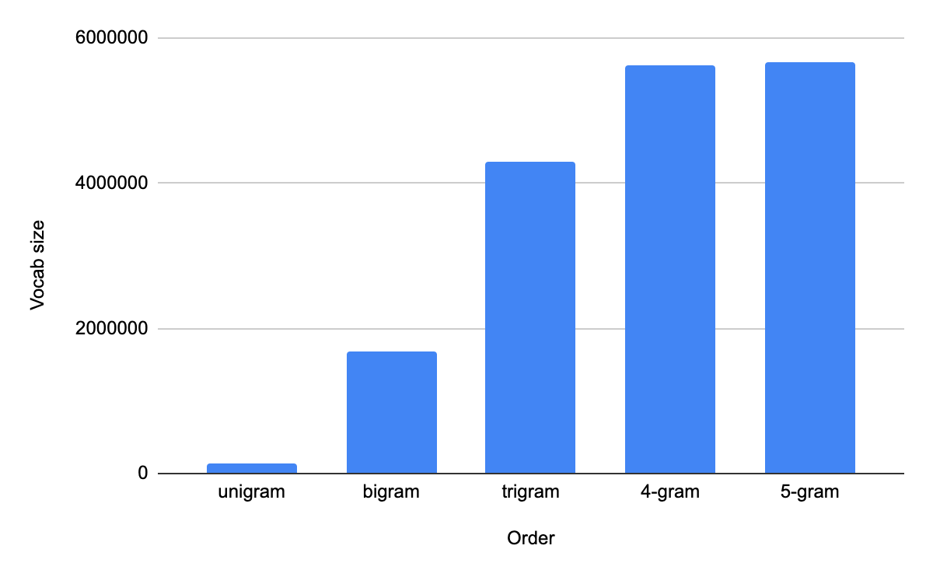
Why don't we use 9-gram LM? or 10-gram?
5-gram LM trained on 8 million words needs to store 17,434,822 parameters

Slide 34
n-gram models rely on accurate counts
If we use higher order model such as 7-gram or 8-gram, the context becomes more and more specific and most counts will be close to zero (more on this later). We can notice that the vocab size gets very large.
More parameters require more data

Slide 35
Estimating n-gram probabilities

Slide 36
Estimate all bigram probabilities
<s> I am Sam </s>
<s> Sam I am </s>
<s> I do not like green eggs and ham </s>

Slide 37
Bigram counts
 | I | want | to | eat | chinese | food | lunch | spend
I | 5 | 827 | 0 | 9 | 0 | 0 | 0 | 2
want | 2 | 0 | 608 | 1 | 6 | 6 | 5 | 1
to | 2 | 0 | 4 | 686 | 2 | 0 | 6 | 211
eat | 0 | 0 | 2 | 0 | 16 | 2 | 42 | 0
chinese | 1 | 0 | 0 | 0 | 0 | 82 | 1 | 0
food | 15 | 0 | 15 | 0 | 1 | 4 | 0 | 0
lunch | 2 | 0 | 0 | 0 | 0 | 1 | 0 | 0
spend | 1 | 0 | 1 | 0 | 0 | 0 | 0 | 0
 | Unigram
I | 2533
want | 927
to | 2417
eat | 746
chinese | 158
food | 1093
lunch | 341
spend | 278

Slide 38
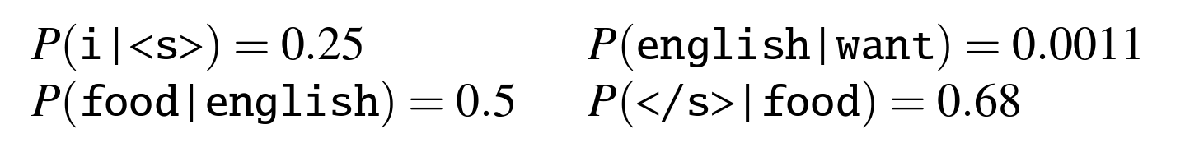
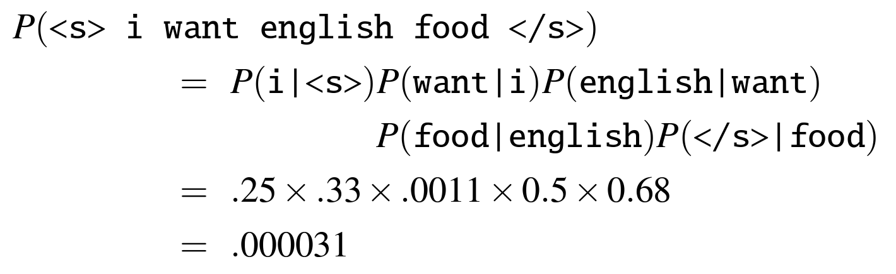
'Normalizing' by dividing by unigram counts
 | I | want | to | eat | chinese | food | lunch | spend
I | 0.002 | 0.326 | 0.000 | 0.004 | 0.000 | 0.000 | 0.000 | 0.001
want | 0.002 | 0.000 | 0.656 | 0.001 | 0.006 | 0.006 | 0.005 | 0.001
to | 0.001 | 0.000 | 0.002 | 0.284 | 0.001 | 0.000 | 0.002 | 0.087
eat | 0.000 | 0.000 | 0.003 | 0.000 | 0.021 | 0.003 | 0.056 | 0.000
chinese | 0.006 | 0.000 | 0.000 | 0.000 | 0.000 | 0.519 | 0.006 | 0.000
food | 0.014 | 0.000 | 0.014 | 0.000 | 0.001 | 0.004 | 0.000 | 0.000
lunch | 0.006 | 0.000 | 0.000 | 0.000 | 0.000 | 0.003 | 0.000 | 0.000
spend | 0.004 | 0.000 | 0.004 | 0.000 | 0.000 | 0.000 | 0.000 | 0.000

Slide 39
Linguistic knowledge and world knowledge in LM
 | I | want | to | eat | chinese | food | lunch | spend
I | 0.002 | 0.326 | 0.000 | 0.004 | 0.000 | 0.000 | 0.000 | 0.001
want | 0.002 | 0.000 | 0.656 | 0.001 | 0.006 | 0.006 | 0.005 | 0.001
to | 0.001 | 0.000 | 0.002 | 0.284 | 0.001 | 0.000 | 0.002 | 0.087
eat | 0.000 | 0.000 | 0.003 | 0.000 | 0.021 | 0.003 | 0.056 | 0.000
chinese | 0.006 | 0.000 | 0.000 | 0.000 | 0.000 | 0.519 | 0.006 | 0.000
food | 0.014 | 0.000 | 0.014 | 0.000 | 0.001 | 0.004 | 0.000 | 0.000
lunch | 0.006 | 0.000 | 0.000 | 0.000 | 0.000 | 0.003 | 0.000 | 0.000
spend | 0.004 | 0.000 | 0.004 | 0.000 | 0.000 | 0.000 | 0.000 | 0.000

Slide 40
Practical issues
The product of small numbers creates too many zeros. We use the sum of log instead aka log probability of a sentence
log(abc) = log(a) + log(b) + log(c)

Slide 41
Evaluating language models

Slide 42
Evaluation methodology
Extrinsic evaluation: evaluating on downstream tasks
Train the LMs on the same training set
Test the LMs on other tasks such as predictive keyboard, machine translation, speech recognition, grammatical error correction
Intrinsic evaluation
Split the dataset into train, dev, test sets
Compute perplexity on dev and/or test set(s)

Slide 43
Extrinsic evaluation
Machine translation - compute translation quality (BLEU score) when using a new LM to rank translations
Speech recognition - compute word error rate when using a new LM to decode the speech into text
Predictive keyboard - compute the accuracy and the keystroke discount when using a new LM to predict the next word as the users type on the keyboard

Slide 44
Pros and cons of extrinsic evaluation
Pros
Real-world relevance
We can use many metrics from many tasks
Cons
Expensive and time-consuming
LMs that perform well in one task might not perform well in another.

Slide 45
Intrinsic Evaluation
Not relying on external tasks
A better LM gives a higher probability to the words in the test set.
We compute perplexity as a standard measure for LM performance. If a language model is good at predicting the next word, it is less perplexed (งุนงง) when we reveal the next word.

Slide 46
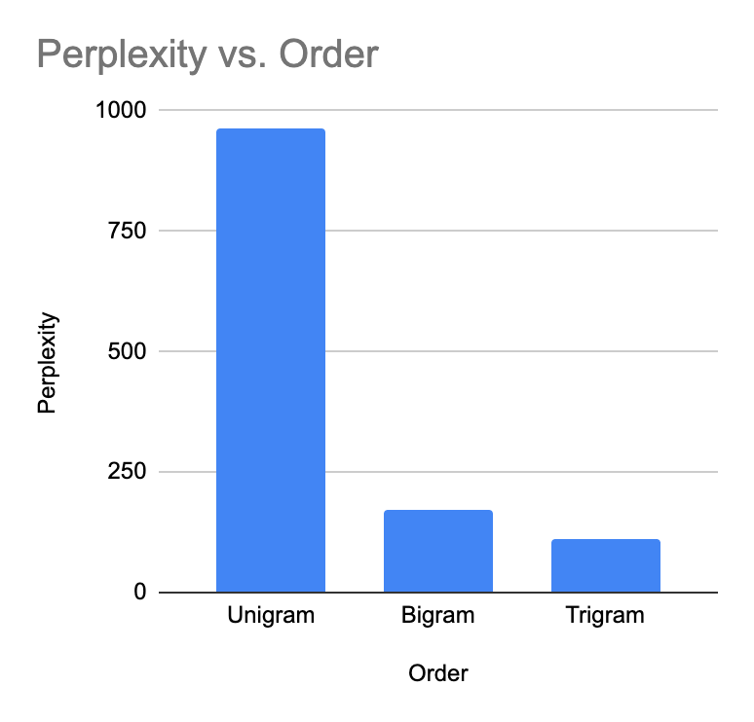
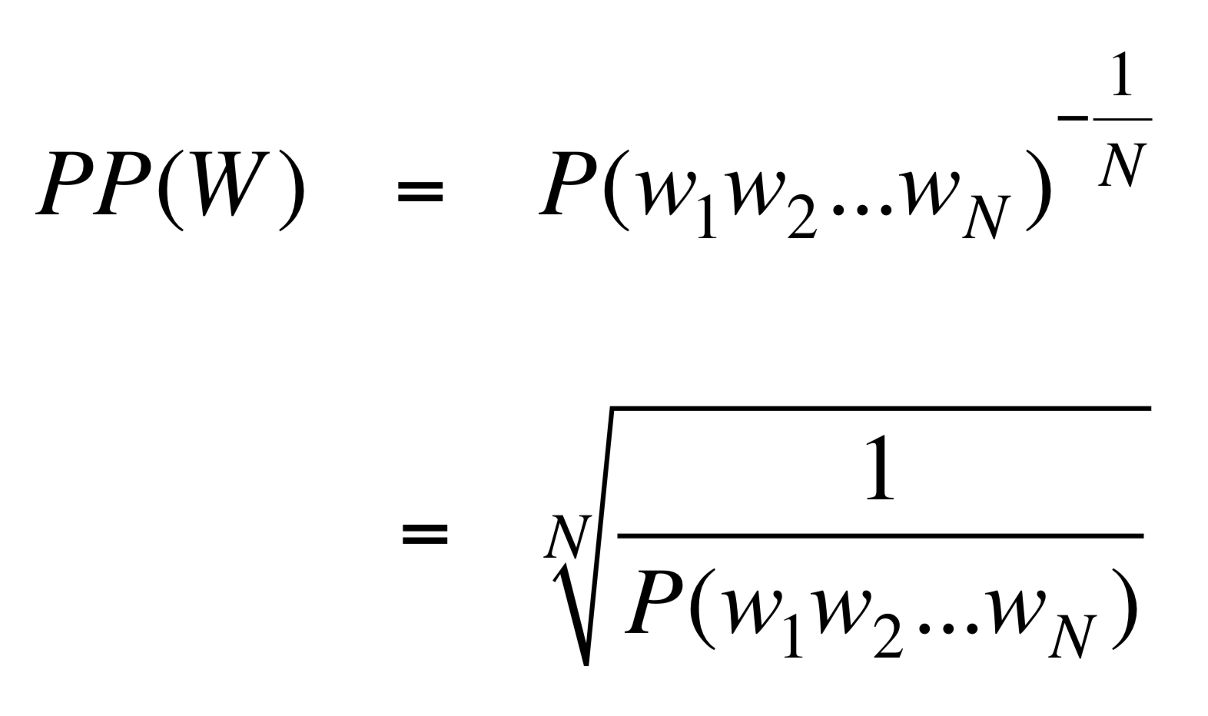
Perplexity (lower = better)

Slide 47
Intuition for perplexity
When comparing two LMs, the better LMs will give a higher probability to the test set than the worse LMs.
Perplexity is the inverse probability of the test set, so the lower the better.
Perplexity is normalized by the number of words.

Slide 48
Language Models can compute probabilities of sentences

Slide 49
N-Gram Language Modeling Tools
KenLM: Kneser-Ney
SRILM: Katz, Witten-Bell, Kneser-Ney

Slide 50
Grammar Check
A good language models should output the higher probability to the sentence that is more 'English-y'
I look forward to meeting you
I look forward to meet you
A grammatical English sentence should be more 'English-y'

Slide 51
English Grammatical Errors
28 types!
https://www.aclweb.org/anthology/W14-1701.pdf

Slide 52
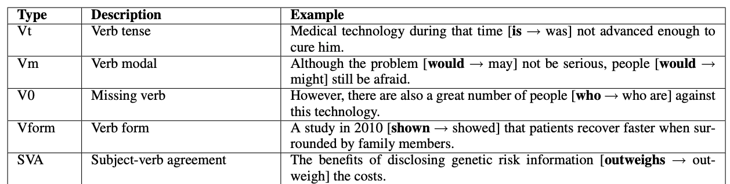
Verbs

Slide 53
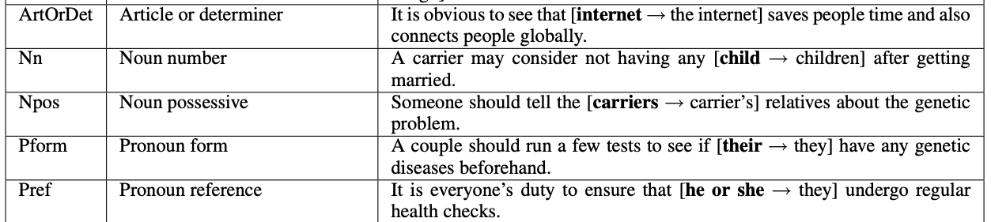
Determiner and Nouns

Slide 54
Preposition
This essay will [discuss about → discuss] whether a carrier should tell his relatives or not.

Slide 55
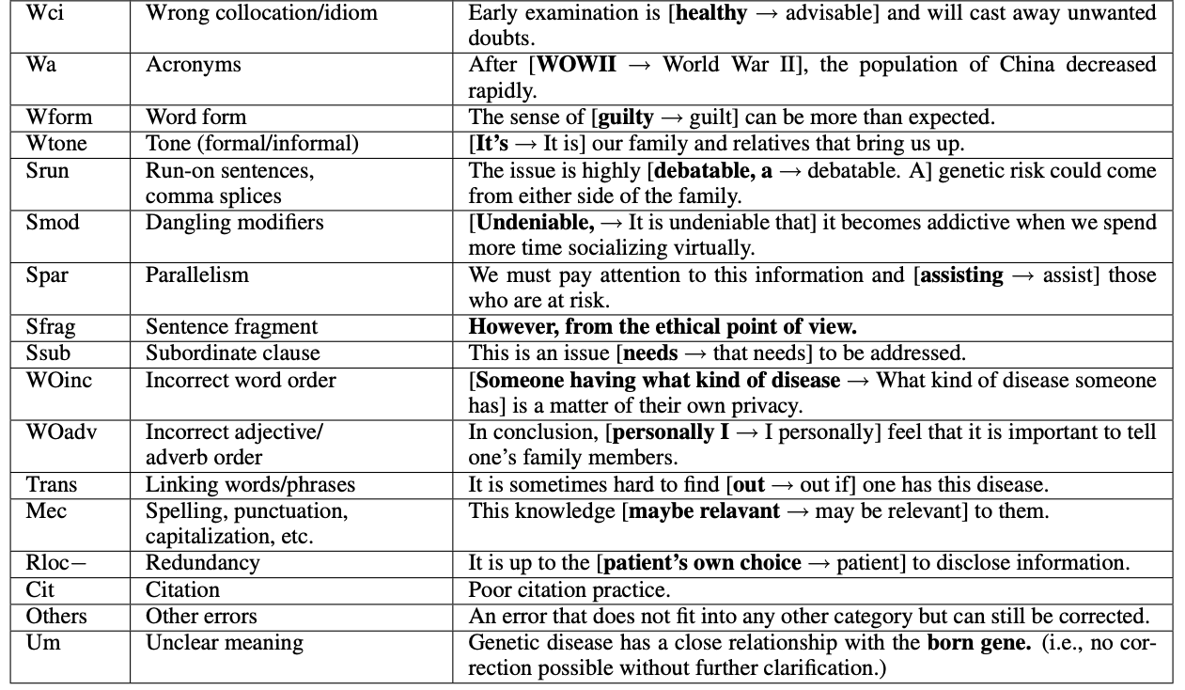

Slide 56
Most common types of errors
Error type | Frequency | Recall
Article | 14.8 | 54.74
Word collocation or idiom | 11.8 | 15.18
Redundancy | 10.5 | 26.47
Verb tense | 7.11 | 20.00
Word form | 4.8 | 46.59

Slide 57
5-gram LM
This essay will discuss about the current issues of climate change
= … x P(issues| discuss about the current) x P(of| about the current issues) x
P(climate| the current issues of) x P(change|current issues of climate)
This essay will discuss the current issues of climate change
= … x P(issues| will discuss the current) x P(of| discuss the current issues) x
P(climate| the current issues of) x P(change|current issues of climate)

Slide 58
Your Turn
Use language models to detect the following errors:
Verb Tense
Verb Agreement
Preposition
Word form such as The circuit suffers from many electrically problems.
Article such as dog is chasing cat

Slide 59
A good language model can generate good text given a context

Slide 60
Sample from a probability distribution over the vocab
0 | a
0 | and
0 | but
0.07 | ethically
0.41 | follow
0.36 | obey
0.02 | orders
… | …
0.08 | rules
0.06 | set
0 | strictly
0 | the
0 | without
P(w| 'a good robot must') = trigram model: 'robot must *' 4-gram model: 'good robot must *'

Slide 61
Sample from a probability distribution over the vocab
0.23 | a
0 | and
0.01 | but
0.02 | ethically
0 | follow
0.02 | obey
0.28 | orders
… | …
0.19 | rules
0 | set
0 | strictly
0.25 | the
0 | without
P(w| 'a good robot must follow') = trigram model: 'must follow *' 4-gram model: 'robot must follow *'

Slide 62
Sample from a probability distribution over the vocab
0 | a
0.03 | and
0.02 | but
0.31 | ethically
0 | follow
0 | obey
0 | orders
… | …
0 | rules
0.27 | set
0.37 | strictly
0 | the
0 | without
P(w| 'a good robot must follow rules') =
trigram model: 'follow rules *' 4-gram model: 'must follow rules*'

Slide 63
Generalizing and zeros

Slide 64
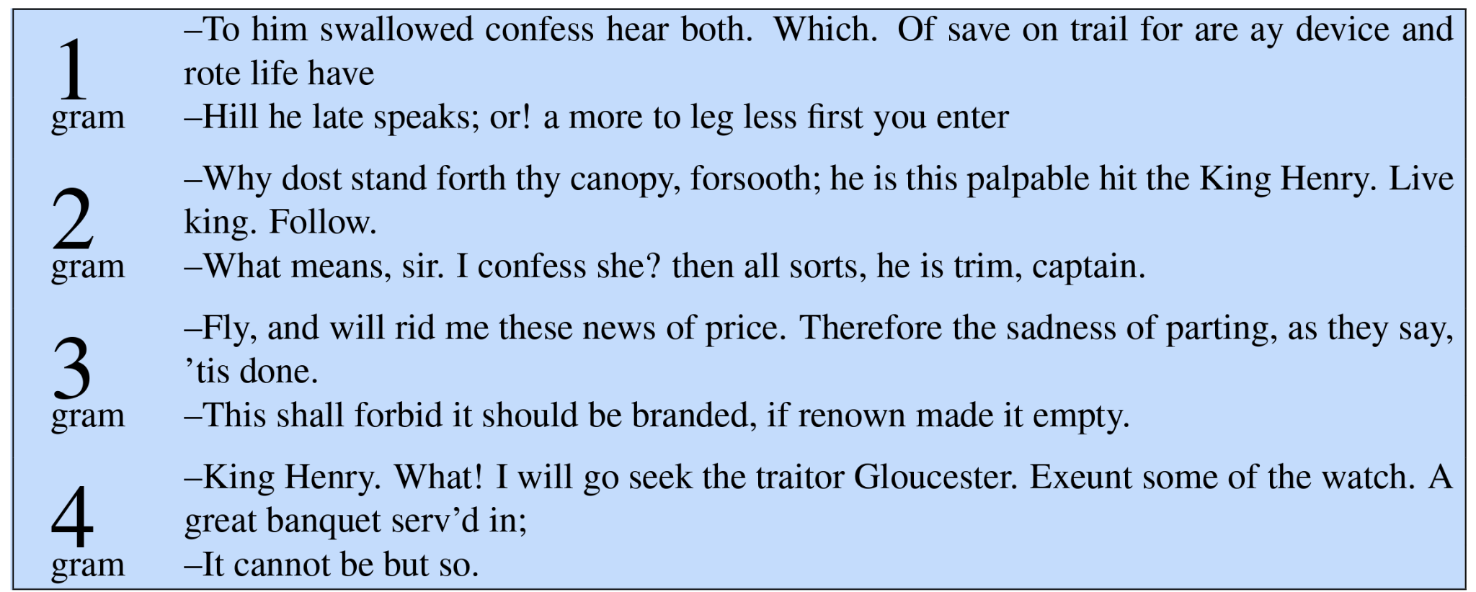
Generating from n-gram models trained on Shakespeare's works

Slide 65
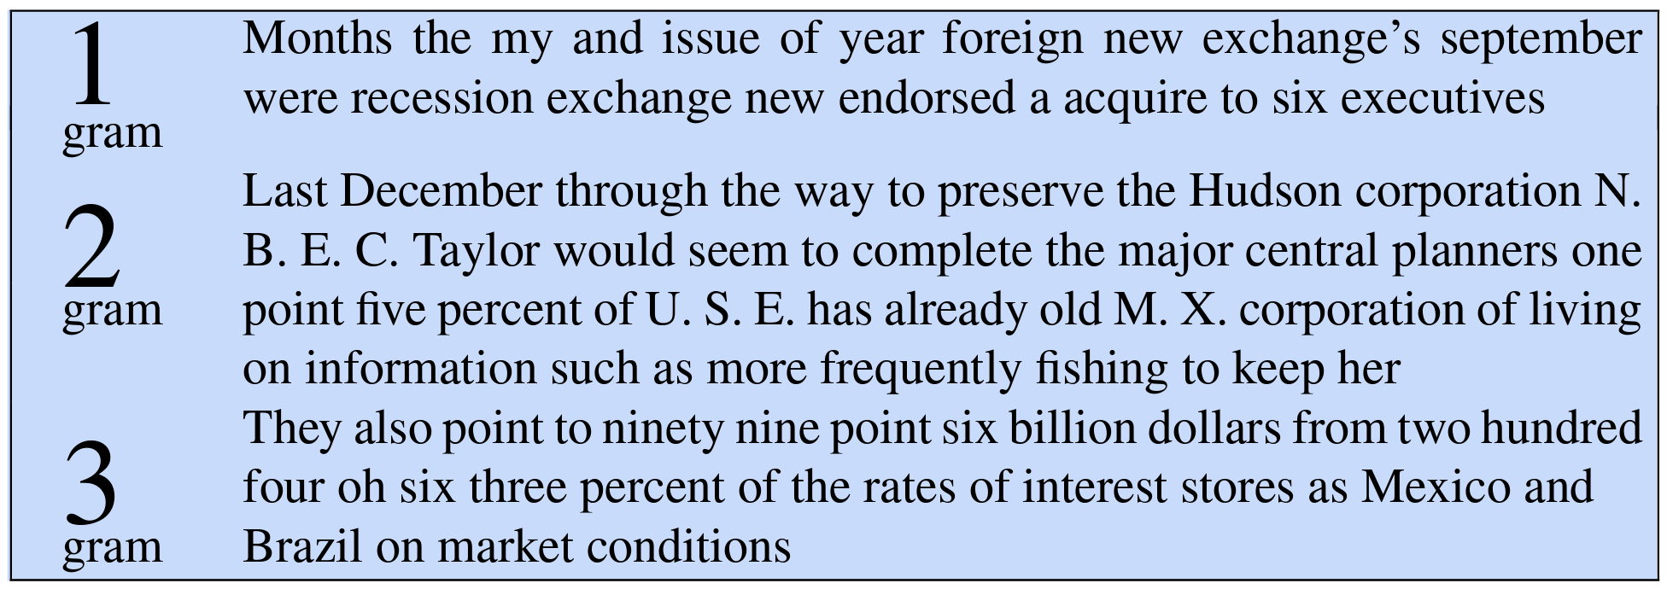
Generating from n-gram models trained on newspaper (Wall Street Journal)

Slide 66
Limitations for n-gram models
n-gram language models only have the information on the strings that are already seen. The generated text stay within the training set.
Languages are infinite. We are guaranteed to find an ngram that we have not seen before. Example:
นักท่องเที่ยว ขุด พบ เรือดำน้ำ
หมา พุดเดิ้ล หาว ดัง

Slide 67

Consider the trigram model: denied the __
We collect the trigrams: denied the allegations 5 denied the speculation 2 denied the rumors 1 denied the report 1

Slide 68
Problems
if this is zero, then probability is zero.
we must smooth the count
P(right | officials deny the) = count(officials deny the right) count(officials deny the)
we have to store millions of counts
if this zero, then divide by 0 = Infinity!
we must backoff to the lower order model such as 4gram → trigram

Slide 69
Good n-gram LM use all of these
Katz LM uses back-off techniques.
Witten-Bell uses linear interpolation (and also back-off in a way)
Kneser-Ney uses both back-off and interpolation.

Slide 70
Generalization and zeros
N-gram models struggle with choosing how much context we should consider
Too much context and the model performs poorly because we do not have enough data. (sparsity problem)
Too little context and the model performs poorly because of long-range dependencies in language.
N-gram models are bound by the n-grams found in the training set only.
N-gram models are still useful for modeling simpler sequences such as syllables in a word (syllable n-gram), characters in a name (character n-gram), etc.

